Slide 1
Personal webpage

Slide 2
Contents
Main Page
Resume

Slide 3
Main Page

Slide 4
1
Navigation Bar

Slide 5
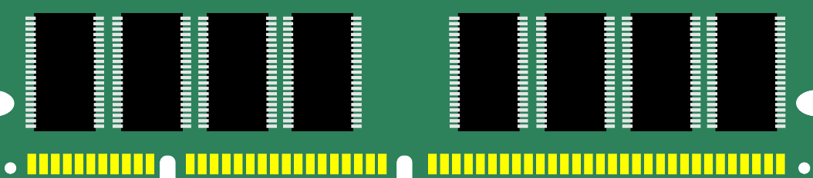
P
Volatile - their state is lost or reset when power is removed from the system.
Holds data/application programs from input devices or storages
Structure : A set of memory chips, each of them is an integrated circuit (IC) made of millions of transistors and capacitors
RAM
Types OF RAM
Static Random Access Memory (SRAM)
Dynamic Random Access Memory (DRAM)

Slide 6
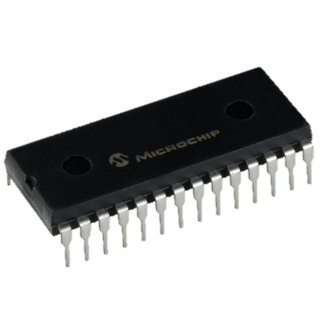
P
Has contents which are fixed when the chip is manufactured
Holds the bootstrap loader part of
the operating system
Retains its data when the computer is switched off
Programmable ROM (PROM)
ROM
Erasable PROM (EPROM)
Types of ROM
Electrically EPROM (EEPROM)

Slide 7
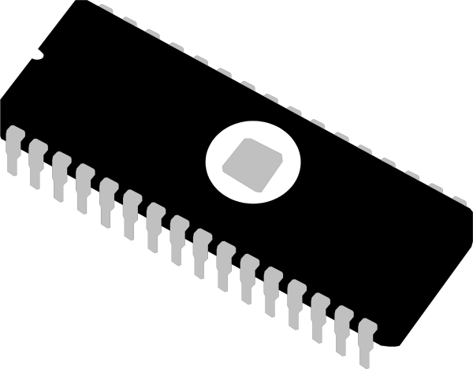
P
Faster and expensive than RAM
It improves the computer’s performance
Processor can use it to store frequently accessed data and program instructions
L1 : primary cache (inside the processor)
L2 : secondary cache (in the motherboard or near the processor)
Cache
Types of cache

Slide 8

P
rajwal Jung Thapa

Slide 9
Our Contents
Introduction
Types
Primary
Secondary

Slide 10
Secondary

Slide 11
3
Secondary Memory
S
long-term storage of data

Slide 12
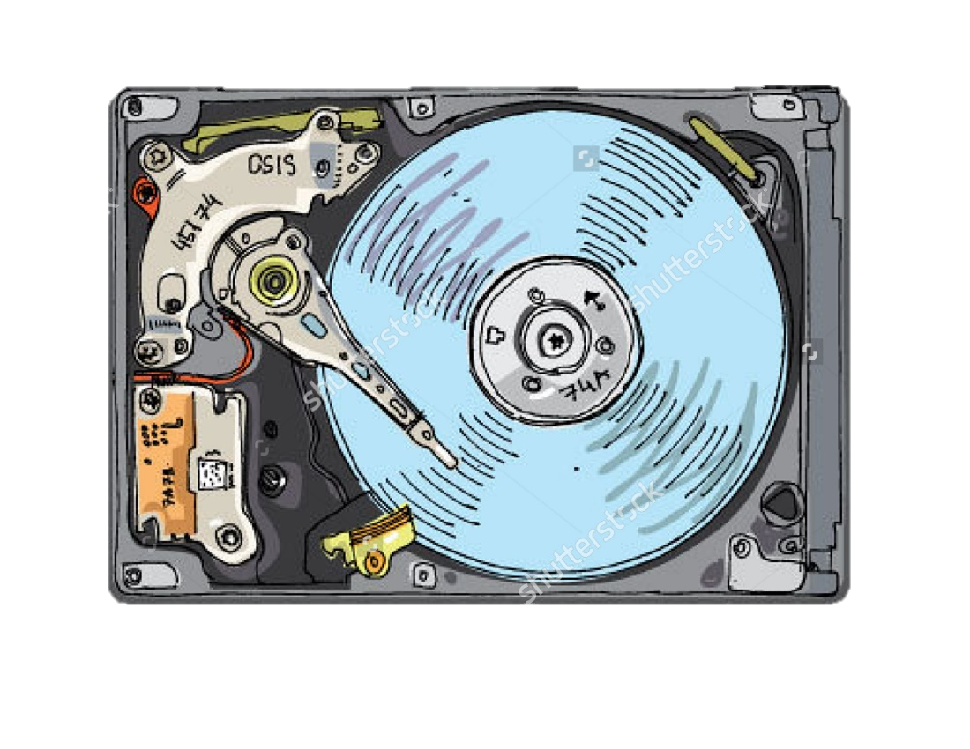
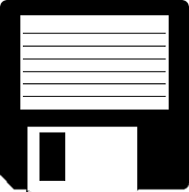
S
First available in 1971
Capacity: 1.44 MB (3 ¹⁄₂-inch floppy disk)
Discontinued.
Since 2010, no motherboard is still manufactured with the support of floppy disk drive.
M
agnetic Storage
Hard Disk Drive
Floppy DIsk

Slide 13
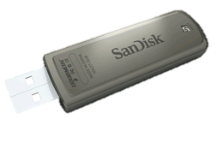
S
Commercially available in 2000
Max. capacity: 1 TB (as of 2013)
Small size
Ideal solution for storing small data
F
lash Drive

Slide 14
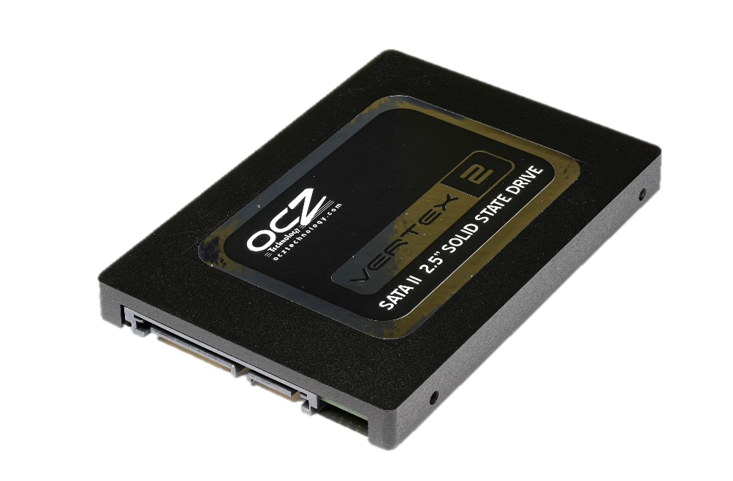
S
First introduced in 1995
Max. capacity: 1 TB (as of 2013)
Very high transferring speed in comparison to normal physical hard disk
S
olid State Drive

Slide 15
THANK YOU!
Do you have any query?

